Slide 1


Final Project Application of RNN for Algorithmic Stock Trading
Patnam, Mohan
CSCI E-89 Deep Learning
Harvard University Extension School
Prof. Zoran B. Djordjević
Notes:
Hello and welcome to my final project “Applicatino of RNN for Algorithmic Stock Trading” done as part of the “Deep Learning” Course. A token of appreciation to the Prof Djordjevic and TAs who organized this course pretty well with a focus on practical aspects of Deep Learning.

Slide 2
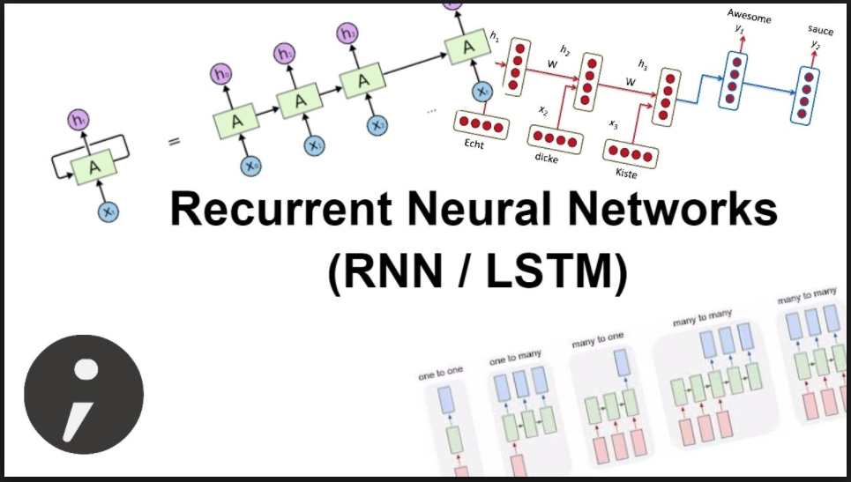
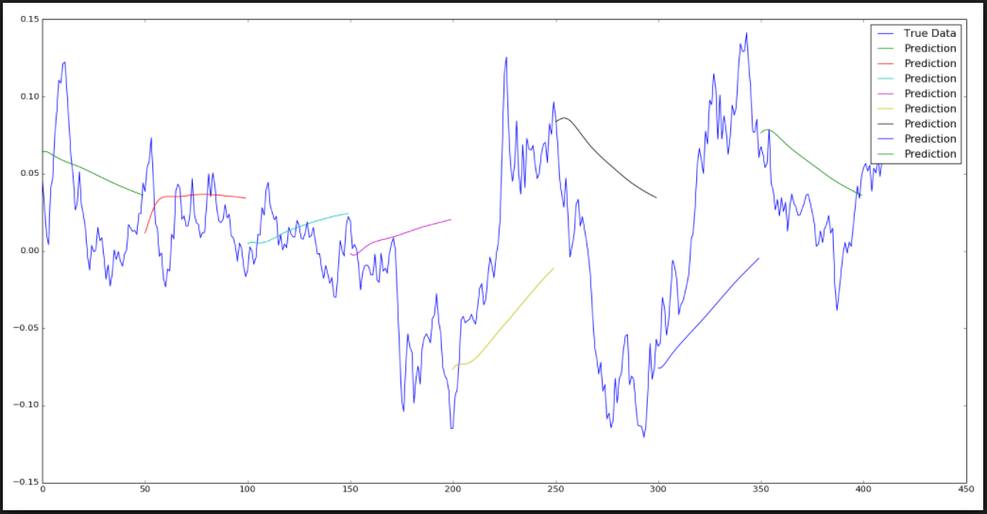
Stock Market + Recurrent Networks
Notes:
Recurrent Neural Networks that includes RNNs and LSTMs are popular for predicting patterns in time-series data. Stock market data which is naturally time-based fits perfectly well here. We will explore to see if we can make reasonable predictions for the short-term intraday prices.

Slide 3
Problem Statement
Application of RNN for algorithmic stock trading with the focus on short-term price prediction using Tensorflow/Keras API for Deep Learning. A case study of single/multi-variate time-series analysis for a chosen stock and its industry sector (Technology) and the stock market index (S&P500) as a whole.
Stock: MSFT (Microsoft Inc.)
Sector: XLK (Tech Sector ETF) – MSFT is 11.80% of XLK portfolio weight
Stock Market: SPY (S&P 500 ETF)
Notes:
Problem Statement: How can we use RNN based convolution networks to predict stock prices, at-least in the short-term? This is the question that this project explores upon by performing various experiments using single or multiple variables as input into RNN model. We specially chose one of the popular tech stocks: MSFT for single-variate analysis. We also wanted to see the effect of tech sector performance on MSFT prices with the help the exchange traded fund “XLK” that represents overall tech sector performance. XLK fund has about 72 different holdings that include MSFT, AAPL, FB etc. MSFT is one of the largest holdings of XLK with about 12%. And lastly we wanted to see if the overall stock market performance as indicated by SPY ETF has any impact on MSFT price movements.

Slide 4
Algorithmic Trading
Definition: Algorithmic trading is a method of executing a large order using automated pre-programmed trading instructions accounting for variables such as time, price, and volume to send small slices of the order out to the market over time.
Popular Strategies (Time/Volume): TWAP (Time-Weighted Average Price), VWAP (Volume-Weighted Averge Price), POV (Percentage of Volume).
Goal: Reduce transaction costs by optimizing the execution. Short term (30-min, 1-hour) predictions can help!
Notes:
A brief introduction to Algorithmic Trading that is popular within Wall-Street for automating the execution of stock orders. It is a method of executing a large order using automated trading instructions accounting for variables such as time, price and volume to send small slices of the order into the market over time.

Slide 5
Project Data
QuantQuote (https://quantquote.com/)
Historical Intraday Stock Data
One-min resolution for 3 years (2014-2017) https://quantquote.com/historical-stock-data
Data download for 100 US stocks, XLK (tech ETF) and SPY.
Sample Minute Data https://quantquote.com/sample/SPY_MINUTE_TRADE.csv
Total downloaded files:
Stocks: 135000+ files for a period of 3 years
ETF (XLK and SPY): 1960 files for a period of 3 years
Total data size: 3.3G (2014 to 2017)
Actual data used: ~15M (2014).
Notes:
Lets talk about the elephant in the room. The data! We used one-min resolution stock data for a period of one year (2014) downloaded from quantquote.com, a data vendor that sells market data with different time resolution. We downloaded for about 100 US stocks that includes MSFT and XLK/SPY data as well. Even though the total data downloaded is more than 3gigs, we ended up using only a small portion – one year worth of data for 3 stocks – MSFT/XLK/SPY.

Slide 6
Data Sample
Date/TimeBin: 2014/01/02 09:51AM (New York Time)
Open – Stock open price 33.1314$ @09:51:00 AM
High – Stock highest price for the minute duration starting 09:51AM
Low – Stock lowest price during the same interval
Close – Stock close price 33.1323$ at the minute end @09:51:59AM
Volume – Stock trading volume in shares for the one-min interval.
Date | TimeBin | Open | High | Low | Close | Volume | Split Factor | Earnings | Dividends
20140102 | 948 | 33.1417 | 33.151 | 33.1323 | 33.1323 | 20582 | 1 | 0 | 0
20140102 | 949 | 33.1323 | 33.151 | 33.1323 | 33.151 | 6675.17 | 1 | 0 | 0
20140102 | 950 | 33.1417 | 33.1417 | 33.123 | 33.1323 | 42184 | 1 | 0 | 0
20140102 | 951 | 33.1314 | 33.1323 | 33.1146 | 33.1323 | 11203.4 | 1 | 0 | 0
20140102 | 952 | 33.1323 | 33.1417 | 33.123 | 33.1417 | 19210 | 1 | 0 | 0
Note: Stock Close price is used in all experimentation
Notes:
Here is the raw data sample for MSFT on 2014/01/02 with highlighted row showing the sample for one minute interval – 09:51AM.

Slide 7
Data Preprocess
Data Wrangling
Transformations include extractions, joining, augmentation, cleansing and normalization.
Data Extract
Use samples during trading hours only (09:30 to 16:00 EST)
Data Join
Join XLK and SPY stock data onto the main stock under analysis (MSFT). Address missing samples during join.
Data Augmentation
One-min Return%
Cumulative Return%
RSI (Relative Strength Index) using gain/loss values.
Normalization - using mean/sd.
Notes:
An important step in any deep learning methodology is preparing the data itself. We preprocessed the raw data and extracted all the samples for trading hours only. We then performed an inner join between these 3 stocks to address the missing data for some min samples.

Slide 8
Data Augmentation
DateTime | Close | Volume | Return | Gain | Loss | RSI | CumReturn
1/2/2014 9:30 | 33.6842 | 1319510 | -0.026711621 | 0 | 0.009 | 48.47418 | 0
1/2/2014 9:31 | 33.7157 | 206817 | 0.066779053 | 0.0315 | 0 | 48.47418 | 0.093515654
1/2/2014 9:32 | 33.612 | 227216 | -0.294264221 | 0 | 0.1037 | 48.47418 | -0.214343817
1/2/2014 9:33 | 33.612 | 170074 | 0 | 0 | 0 | 48.47418 | -0.214343817
Augment MSFT data columns
etf.Open | etf.Close | etf.Return | etf.CumReturn | spy.Open | spy.Close | spy.Return | spy.CumReturn
33.2818 | 33.2164 | -0.196503795 | 0 | 170.607 | 170.524 | -0.048649821 | 0
33.2164 | 33.2024 | -0.042147855 | -0.042147855 | 170.524 | 170.529 | 0.002932139 | 0.002932139
33.2071 | 33.2071 | 0 | -0.027998218 | 170.524 | 170.589 | 0.038117802 | 0.038117802
33.2164 | 33.2118 | -0.013848581 | -0.013848581 | 170.58 | 170.598 | 0.010552234 | 0.043395651
Augment XLK data columns
Augment SPY data columns
Return – Stock one-min returns (%)
CumReturn – Stock cumulative return (%)
RSI – Relative Strength Index to indicate whether stock is oversold or overbought.
Gain/Loss – Intermediate columns needed for RSI calculation
Notes:
This is how data looked after pre-process stage with augmented columns from XLK and SPY stocks. Besides “close” price, we will also use “one-min” return during single-variate analysis.

Slide 9
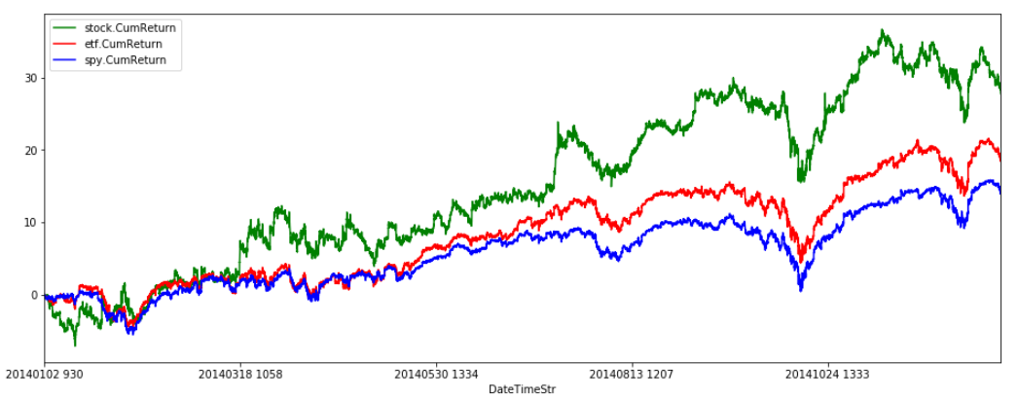
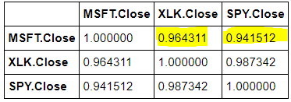
MSFT vs XLK vs SPY correlations
Preprocess output: Stock cumulative returns (%) over one year (2014)
MSFT vs XLK vs SPY. MSFT stock returns correlated well against sector ETF (XLF) and the S&P index (SPY) performances. This relationship explored during RNN multi-variate analysis.
Notes:
Lets see how well these stocks are correlated to each other using 2014 data. We calculated cumulative returns during pre-process and here is the plot that shows the same. We can clearly see that MSFT and XLK are positively correlated (about 0.96) for the most part and likewise, MSFT and SPY as well.

Slide 10
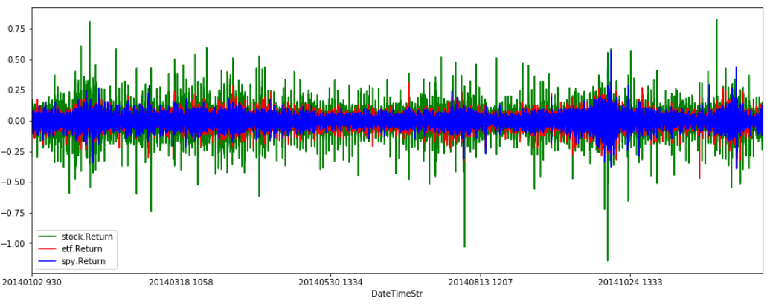
Daily Returns
Preprocess output: Stock daily returns (%) over one year
Volatility of MSFT (stock) > XLK (Industry Sector) > SPY (Overall market)
In general, individual stocks tend move larger on a daily basis compared to the indices representing the industry sector or market.
Notes:
Here is another plot showing one-minute returns for the three stocks with MSFT stock more volatile than XLK. The take away is, individual stocks tend to move larger compared to the indices that represent the inductor sector or the overall market.

Slide 11
RNN Single-Variate time-series prediction
Task:1 Use Stock close price ($).
. Using stock close price at one-min intervals, train the model
to predict the stock prices on a short term hourly basis.
Task:2 Use Stock returns (% gain or loss).
Using stock returns (%) at one-min intervals, train the model to predict the stock returns on a short term hourly basis.
Task:3 Use Stock Up/Down Indicator.
Using stock up/down indicator (logistic) at one-min intervals,
train the model to predict if stock will be up/down on a
short term hourly basis.
Notes:
The first part of the project focused on single-variate analysis and we performed 3 different experiments. We wanted to see how well an RNN based model can predict stock prices in the short-term and like-wise, stock one-min returns. Lastly, we want to explore predicting just the direction of stock price in the near future. Whether price will be simply up or down in the next min, next hour etc.

Slide 12
RNN Multi-Variate time series prediction
Prologue: MSFT vs XLK Correlation (2014 year)
Determine the best 2 month period.
Task:4 Effect of XLK price on MSFT price (Study:1)
Use the same time period as in single-variate analysis.
Train the RNN using MSFT (stock) and XLK (sector) as input to predict short term prices of MSFT.
Task:5 Effect of XLK price on MSFT price (Study:2)
Use the 2-month period with best correlation.
Train the RNN using MSFT (stock) and XLK (sector) as input to predict short term prices of MSFT.
Notes:
The second part of the project focused on the multi-variate analysis using both MSFT and XLK prices as inputs into RNN, in order to predict MSFT prices for the short-term. We did 2 experiments here using two different training period. In one case, we used the 2 month period when MSFT and XLK prices correlated the most and in other case, used the same time-period (which is first two months of 2014) as single-variate analysis done in the first part of the project.

Slide 13
RNN Model Parameters
Training Period – 2 months of stock data (44 Trading days) with one-min resolution samples
Test Period – same 2 months + one additional day (for short-term prediction)
#Samples for each trading day – 6.5 hours * 60 = 390
#Samples for training set – 44 * 390 = 17160
RNN model parameters
#Input Steps = 2 days worth of samples = 2 * 390 = 780
Batch Size = 50
Lag = [60, 120, 180, 240, 300, 360] #minutes for prediction
Each RNN Cell:
#inputs = 1, #neurons = 100, #outputs = 1
Using OutputProjectWrapper (with a FC layer)
Learning Rate = 0.001
#Iterations = 800
Adam Optimizer with ‘MSE’ as the loss function.
Notes:
The RNN model that we specifically designed for stock price prediction uses 2 month training period and an overlapped test period using the same 2 month period and an additional day outside of training period for comparing the performance of the model for short-term predictions. RNN model itself was trained multiple times to predict with different time lags into the future (1hr, 2hrs, all the way to 6hrs). We saved the trained model with weights in the respective files for reload/test purpose. Finally we used Adam optimizer with ‘MSE’ as the loss function.

Slide 14
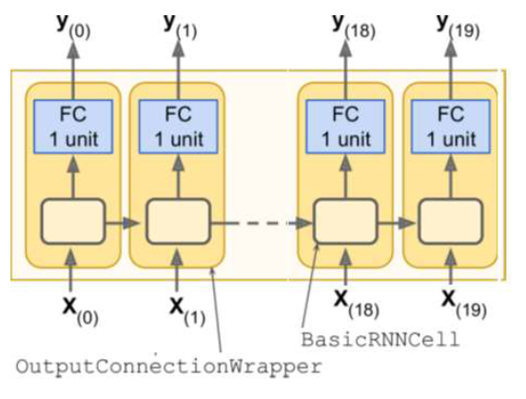
RNN Model
At each time step, we have an output vector of size 100. However, we want one single output representing the stock price.
We will use OutputProjectWrapper with a FC layer to convert output vector to single output value.
#Time steps = 780
Each RNN cell:
#Inputs = 1 (single variate)
#Inputs = 2 (multi-variate)
#Neurons = 100
#Outputs = 1
Notes:
To summarize, RNN model uses 2-days worth of data (780 samples) as #time-stpes with each RNN cell taking either 1-input (for single variate) or 2-inputs (For mult-variate).

Slide 15
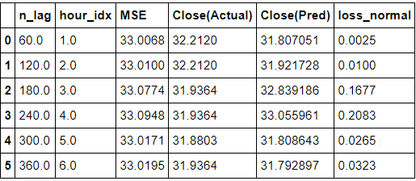
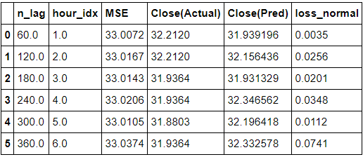
#Time Steps in RNN
Experiment (using XLK stock) to decide #Time Steps – 2 days vs 5 days
#Time Steps using 2 days = 390 * 2 = 780 (faster training)
#Time Steps using 5 days = 390 * 5 = 1950
#Steps = 5 days
#Steps = 2 days
Notes:
We did a small experiment to decide on the #time-steps for the RNN model under consideration. In one experiment, trained RNN model with #time-steps using 5-days worth of data (1950 samples) and in other experiment, used 2-days worth of data (780 samples). We didn’t see any significant difference in the quality of the trained model, as evident from the loss value (MSE). We decided to use 2-days (meaning 780 samples) as the #time-steps for the rest of the experimentation in the project.

Slide 16
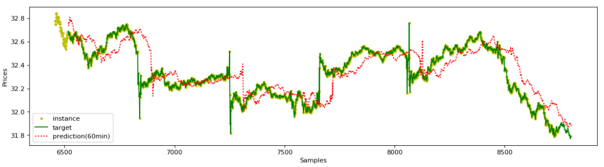
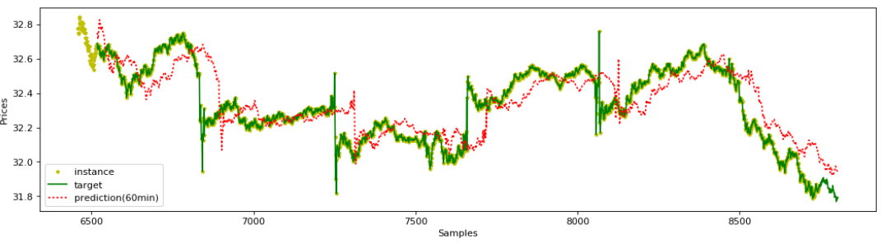
#Steps in RNN (Contd..)
Experiment (using XLK stock) to decide #Steps – 2 days vs 5 days
Performance (60min prediction) is similar in both cases - similar Loss.
#Steps = 5 days
#Steps = 5 days
#Steps = 2 days

Slide 17
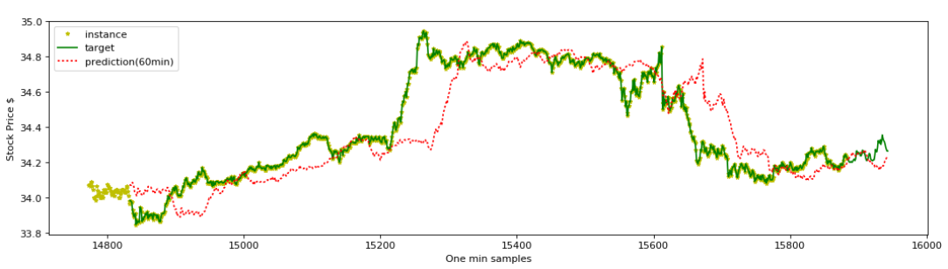
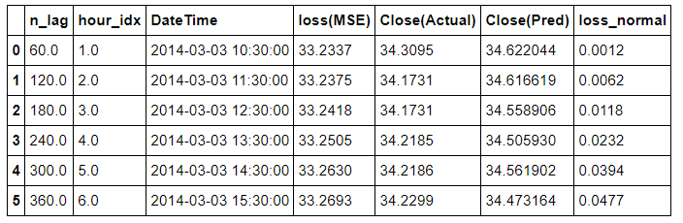
Single Variate Time Series Prediction
Task:1 Use MSFT one-minute Stock close price ($).
Notes:
We will now focus on the results from single-variate and multi-variate RNN models. For the first part with single-variate analysis, task:1 focused on predicting MSFT prices with a time-lag of different 1 hour intervals into future. Results are shown above with the actual vs predicted stock price and the corresdponing loss value in each case. Take-away is, the model captured the overall trend in the stock price though it failed to predict accurately the prices at one-min intervals. This model becomes a base case to compare against rest of the experiments with single-variate analysis.

Slide 18
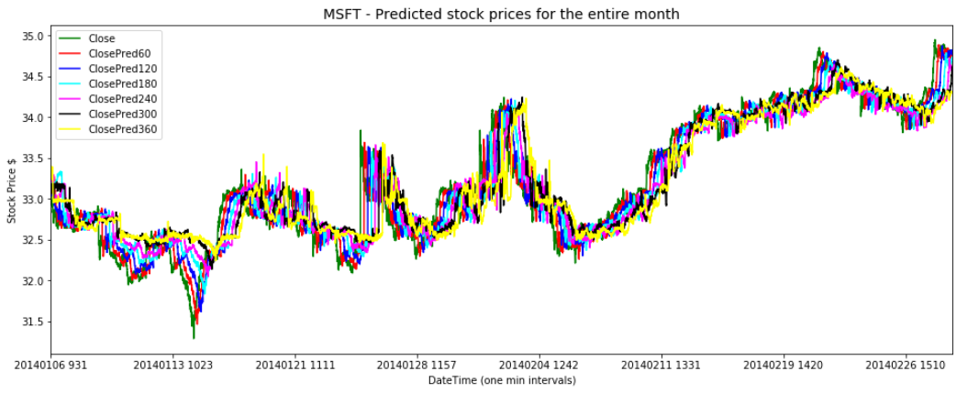
Single Variate Time Series Prediction
Task:1 Prediction of stock price with different time lags -
60min, 120min, 180min, 240min, 300min, 360min
We see that the predictions getting worse as the prediction window grows. We do see that the predictions have picked-up for short term (60min window) and overall, picked the long-term patterns.
Notes:
Continuation of previous experiment, prediction of stock price with different time lags into the future – upto 6 hours. We see that the predictions getting worse as the prediction window grows. We do see that the predictions have picked-up for short term (60min) and overall, picked the long term patterns.

Slide 19
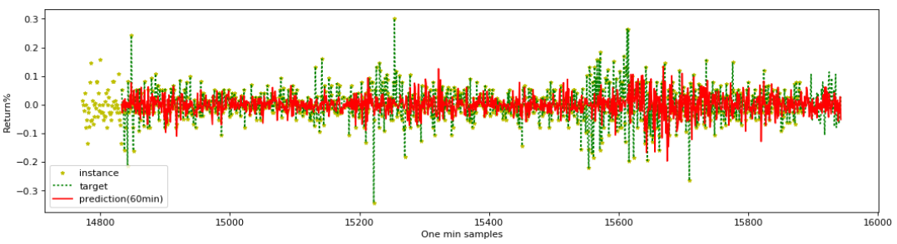
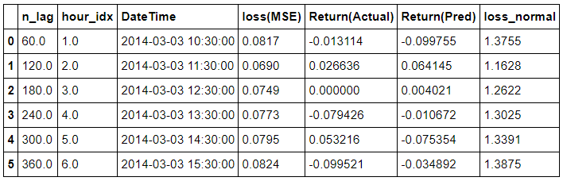
Single Variate Time Series Prediction
Task:2 Use MSFT one-minute Stock returns (%gain or loss).
Notes:
This is the second experiment in single-variate analysis to predict stock returns (%) instead of stock price in the near future. This model performed worse than previous model prediciting stock prices as shown by the normalized loss values .

Slide 20
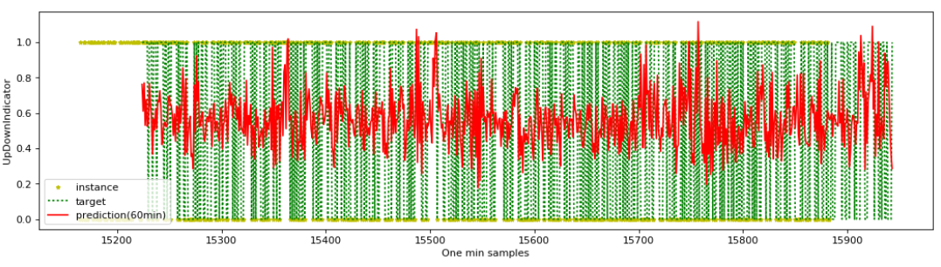
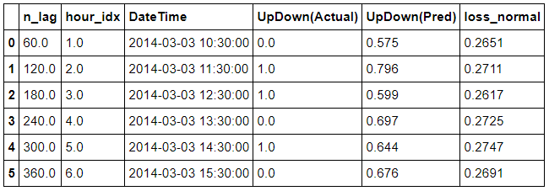
Single Variate Time Series Prediction
Task:3 Use MSFT Stock Up/Down Indicator
Notes:
Finally, the last experiment wanted to just predict the direction of stock price movement in the near future – up or down. This model performed much better compared to the previous one.

Slide 21
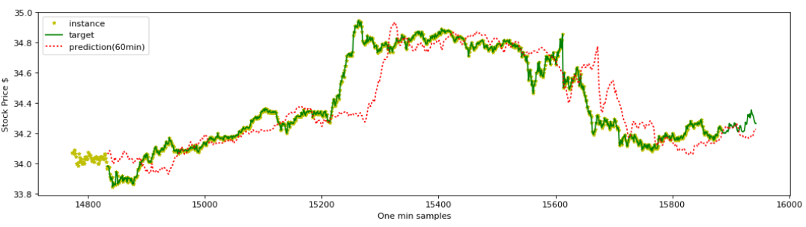
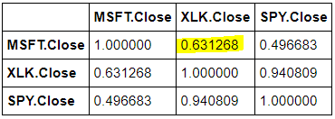
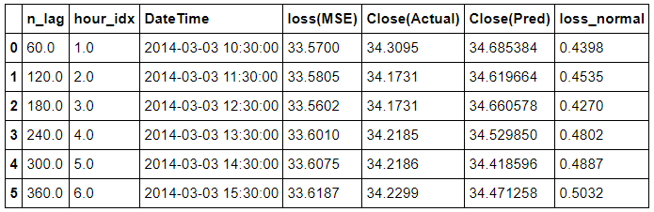
Multi Variate Time Series Prediction
Task:4 Effect of XLK prices on MSFT price for the same period (2014/01 to 2014/02) as single-variate analysis (Task:3)
Notes:
Lets move onto the multi-variate RNN prediction. We analysed the impact of XLK price on MSFT price by inputting both MSFT and XLK prices into RNN model. The first part of the experiment focused on the same time period as single-variate analysis and the results are worse, as shown by loss (MSE) values. Part of the reason is that MSFT was only modestly correlated to XLK (corr = 0.63) during this time-period.

Slide 22
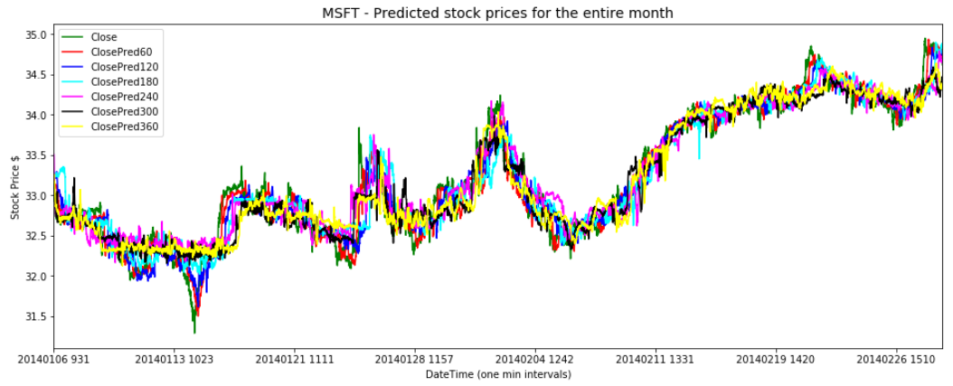
Multi Variate Time Series Prediction
Task:4 Prediction of stock prices with different lag
60min, 120min, 180min, 240min, 300min, 360min
We see that the predictions getting worse as the prediction window grows. We do see that the predictions have picked-up for short term (60min window) and overall, picked up the long-term patterns.
Notes:
Continuation of the previous experiment, showing the prediction with different time-lags into future. We see that the predictions getting worse as the prediction window grows. In particular, peaks and valleys have been smoothed by 360 min prediction line.

Slide 23
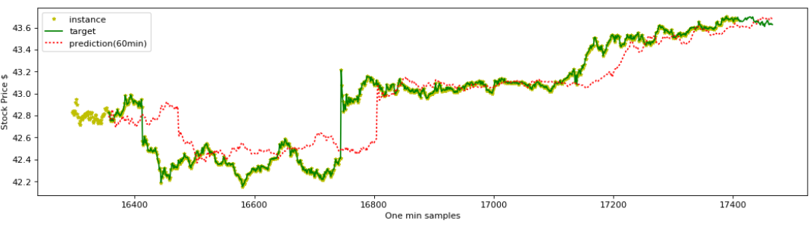
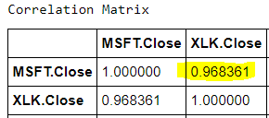
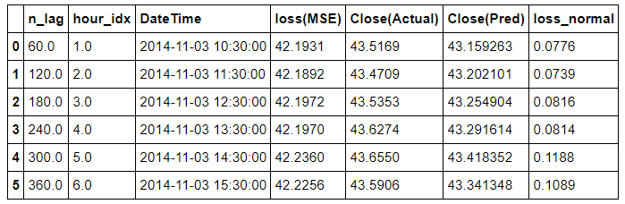
Multi Variate Time Series Prediction
Task:5 Effect of XLK prices on MSFT price for the period when XLK and MSFT are best correlated (2014/09 to 2014/11).
Notes:
Now, last but not least, we repeated the multi-variate experiment using the time-period when MSFT and XLK were positively correlated the most (with 0.968) during 2014 year. The performance was much better when compared to the previous one with lower loss values.

Slide 24
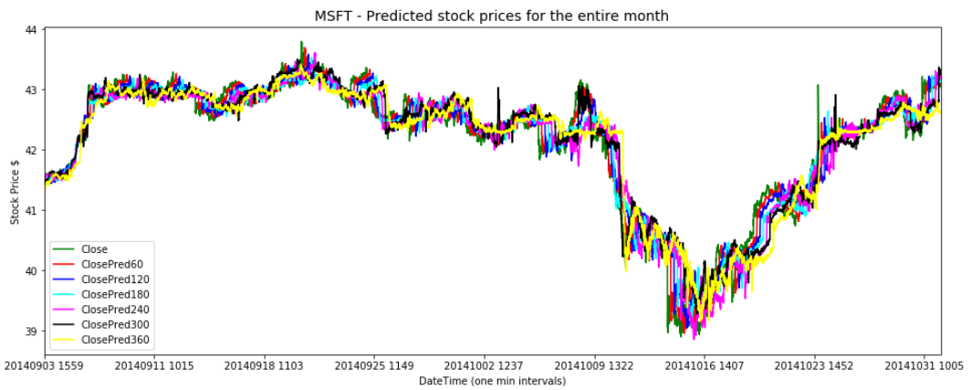
Multi Variate Time Series Prediction
Task:5 Prediction of stock prices with different lag
60min, 120min, 180min, 240min, 300min, 360min
We see that the predictions overall very tight and remains same regardless of window size. The model performed relatively better compared to the previous experiment using different training period. Model also performed better than single-variate analysis in the previous section.
Notes:
Continuation of the same experiment, showing predicted prices with different time-lags. We see that the predictions overall very tight and remains same regardless of window size. The model performed relatively better compared to the previous experiment using different training period. Model also performed better than single-variate analysis in the previous section.

Slide 25
Conclusion
Presented a general pipeline of data download, wrangling and normalization for single vs multi-variate time series prediction using one-min stock prices, trained appropriate RNN based models in each case with varying parameters.
Performed multiple experiments ranging from prediction of stock price direction (up/down) in the near future to the prediction of stock prices and returns %.
Summary of results:
Evaluated the model with two different time-steps (5 days vs 2 days) and observed performance remaining same.
Single Variate (using MSFT price):
The model that predicted stock prices in the near future performed better compared to predicting stock movement (up/down) or stock returns (%).
Multi Variate (using MSFT + XLK prices):
Adding a correlated variable (XLK price) as additional input has shown improvement with a lower loss (MSE).
Notes:
In conclusion, we presented a general pipeline of data download, wrangling and normalization for single vs multi-variate RNN models using one-min stock prices, training appropriate RNN models in each case with varying training periods etc.

Slide 26
Pros & Cons
Pros:
Simple RNN based model demonstrating single vs multi-variables as input.
RNN model performed reasonably well to predict the stock prices as well as direction (up/down). Loss (MSE) is minimal.
RNN model can be easily extended to have multiple inputs to see the effects of related variables. This was demonstrated using multi-variate time series prediction.
Cons:
Predicting stock prices is not an easy task! RNN based models typically suffer from amnesia as it cannot capture longer term patterns satisfactorily.
Need more sophistical learning models involving LSTMs etc to capture longer term relationships that affect stock prices.
Stock price movements, in reality, depend on multitude of other factors including company’s earnings, market sentiment, geo-political and macro-economic events etc. RNN based model can perform better if additional data representing above factors can be provided as input.

Slide 27
Extended work
Perform RNN multi-variate analysis with additional inputs such as data related to company’s earnings, technical factors, geo-political/macro-economic events etc.
An LSTM based model using the same input should produce better results (in theory).
Run the model on a test period completely outside of training period. Current work has overlapping test/training period.
Address overfitting using regularization (Eg: Dropout).

Slide 28
YouTube videos
2-min video
https://youtu.be/u5YZMcV-QVY
15-min video
https://youtu.be/DrUFj00Sky4

